Slide 1
Intro

Slide 2
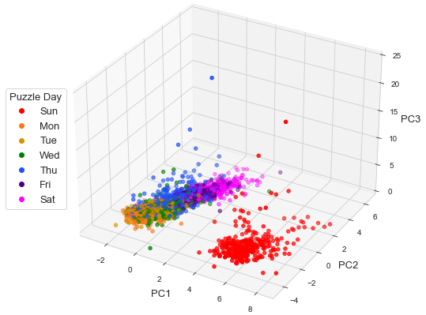
Notes:
Fig. 1

Slide 3
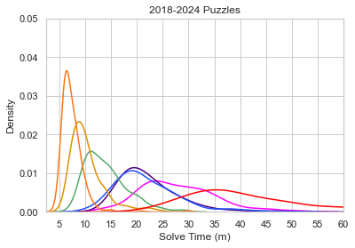
Notes:
Fig. 2

Slide 4
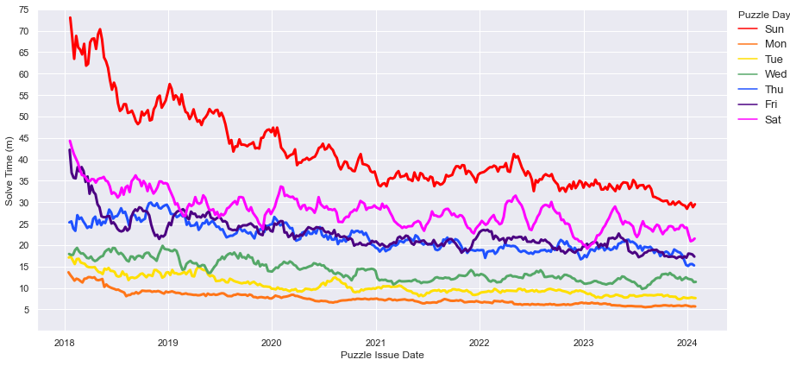
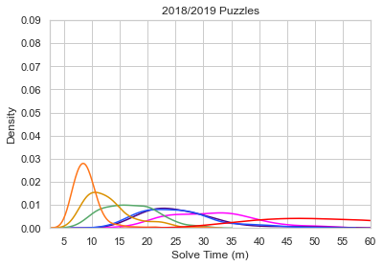
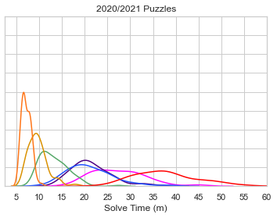
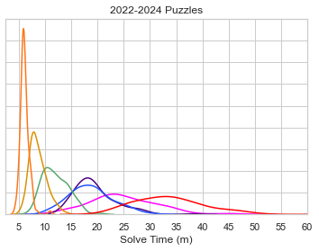
Notes:
Fig. 3

Slide 5
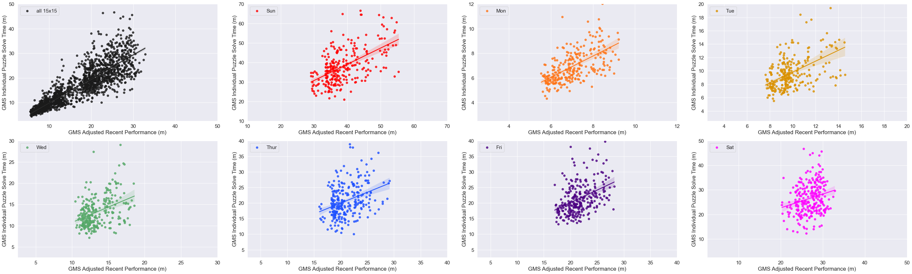
Notes:
Fig. 4

Slide 6
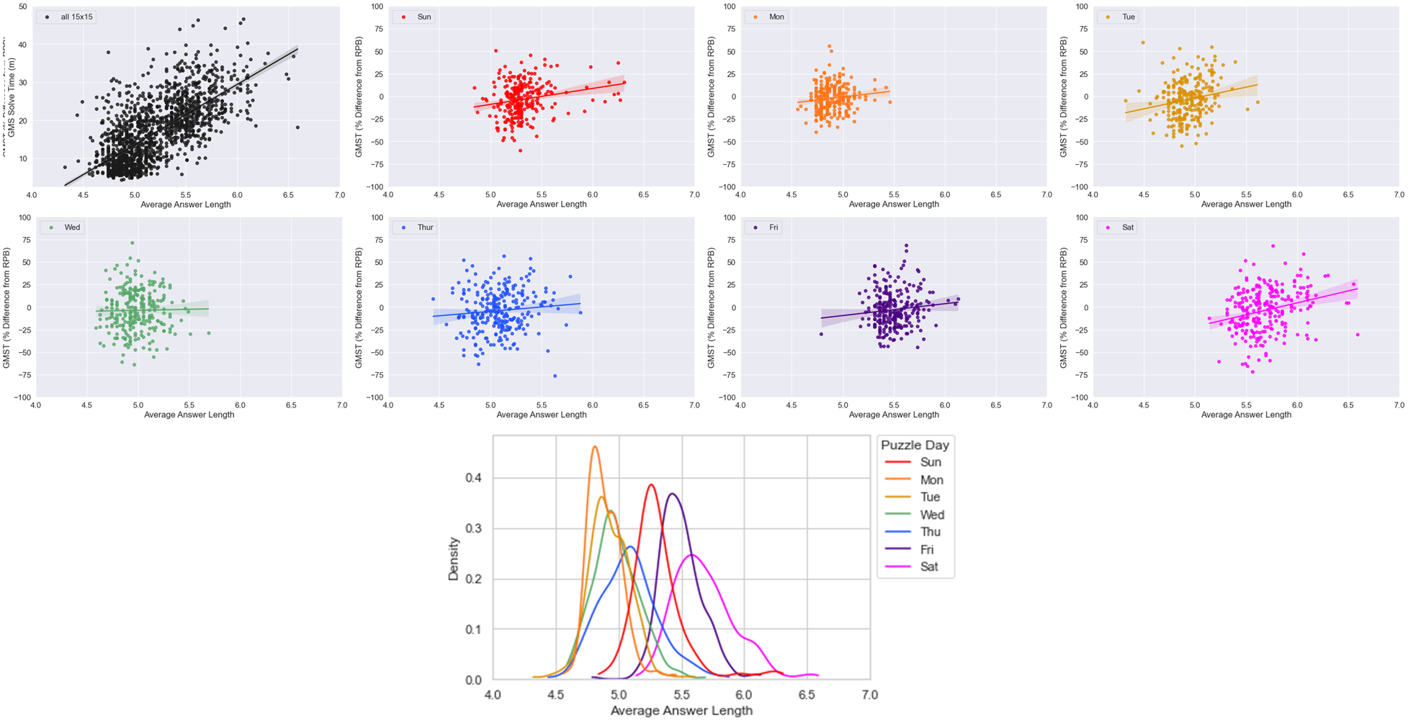
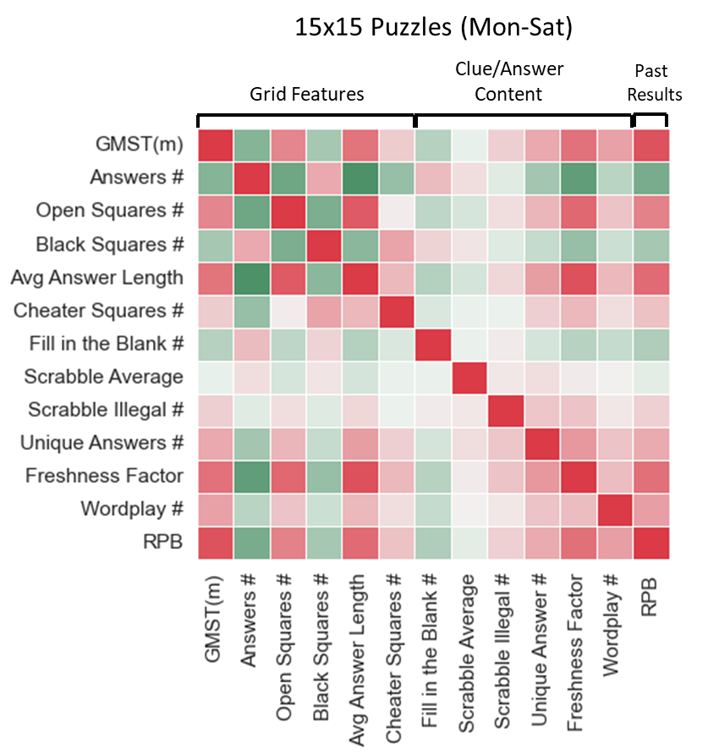
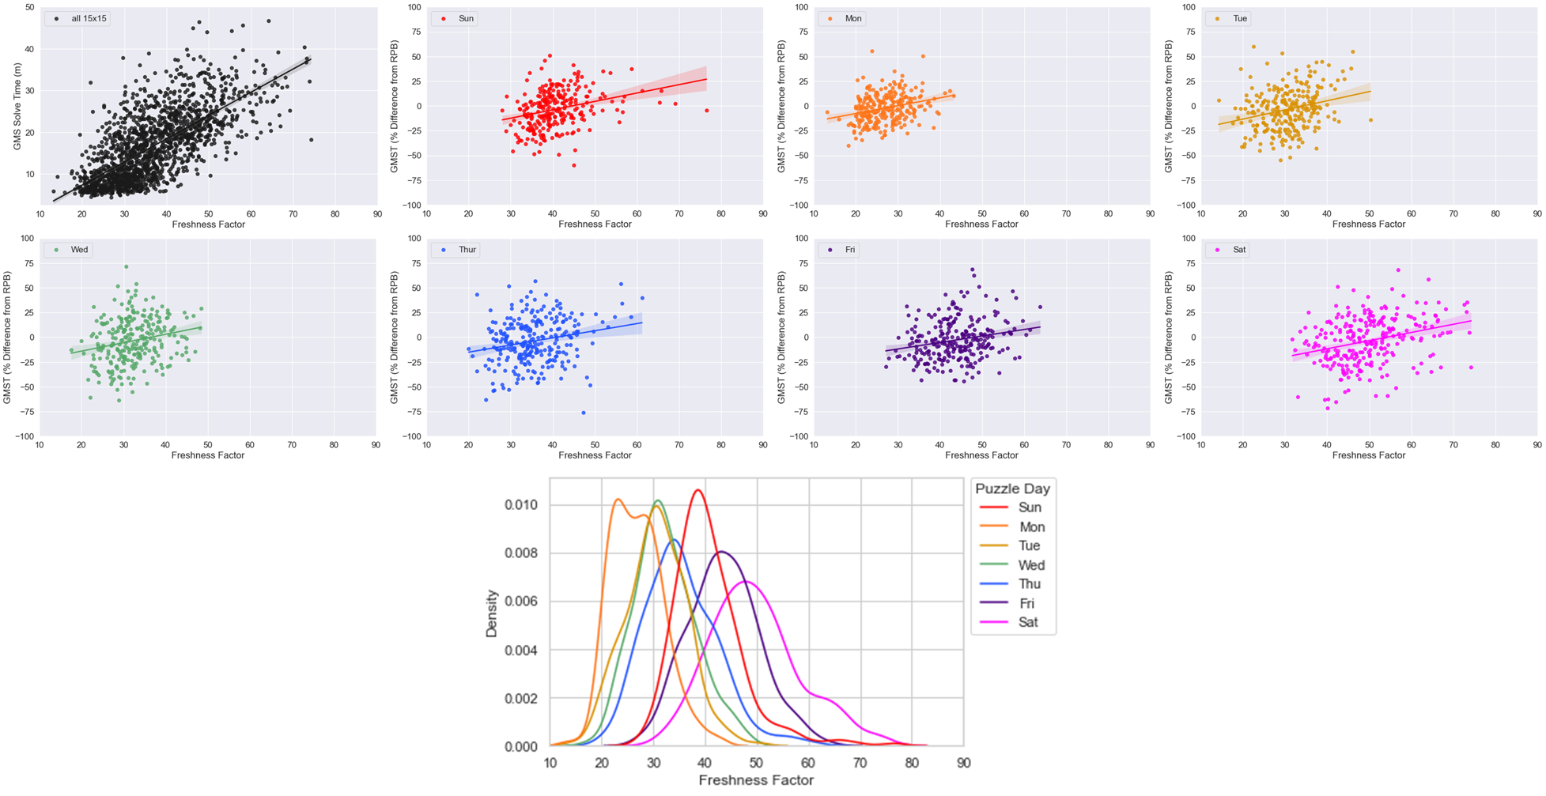
Notes:
Figure 5

Slide 7
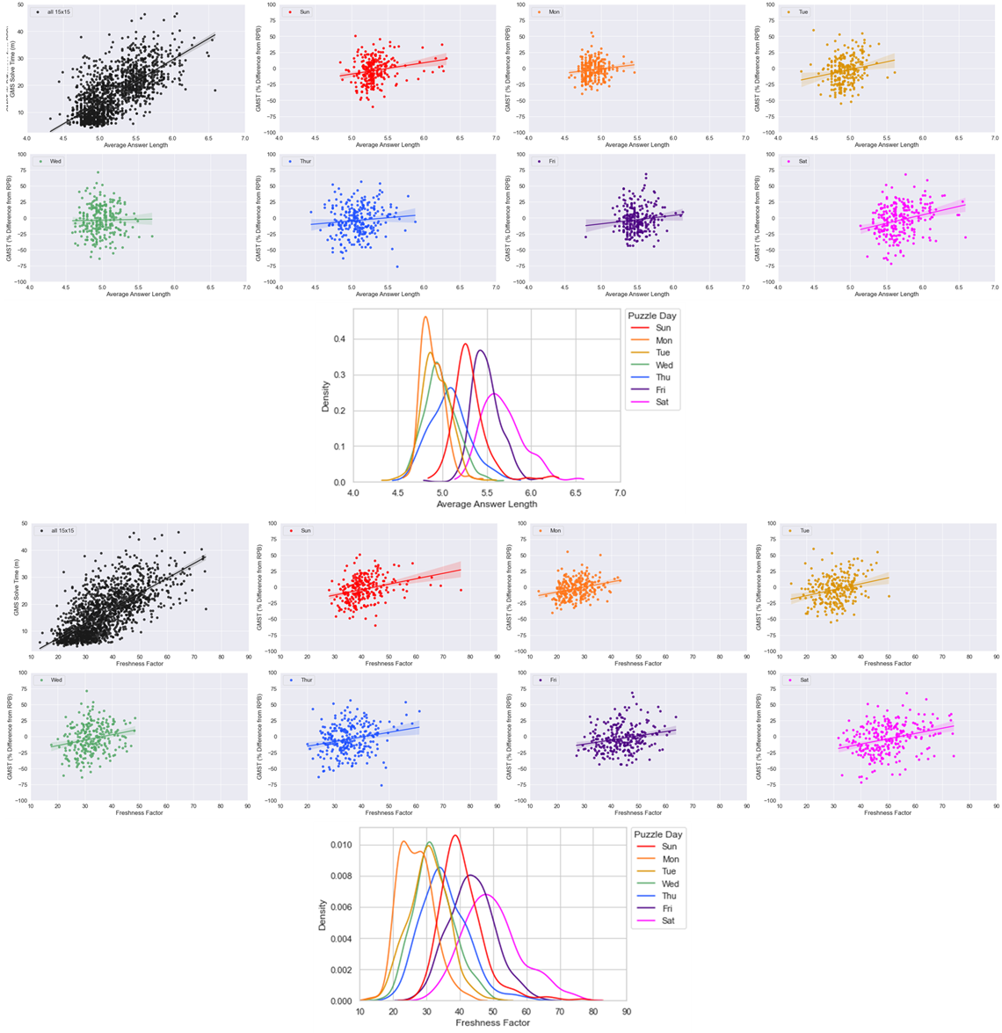
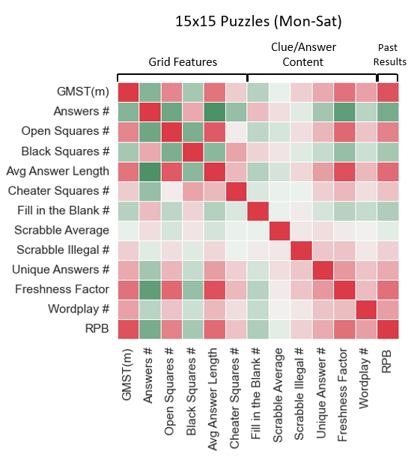
Notes:
Fig. 5

Slide 8
Methods

Slide 9
Solver Past Performance Features (n=7)
Decay-Time Weighted
(n=2/7)Dem
PREDICTED 15x15 PUZZLE
(TARGET FEATURE: % TOTAL POINTS PLAYED WON PER PLAYER)
0
SHORT-TERM PAST PERFORMANCE FEATURES ACCRUED
(Prior 10 Day-Specific Puzzles)
Puzzle: Clue or Answer Features
(n=19)
-10
INTERMEDIATE-TERM PAST
PERFORMANCE FEATURES
(Prior 25)
Puzzle Day of Week
(n=1)
-25
Increasing
Weight
LONG-TERM PAST
PERFORMANCE FEATURES
(Prior 40)
Puzzle: Grid Features
(n=11)
# Day-Specific Puzzle Prior to Predicted Puzzle
-40
Notes:
Fig. 2

Slide 10
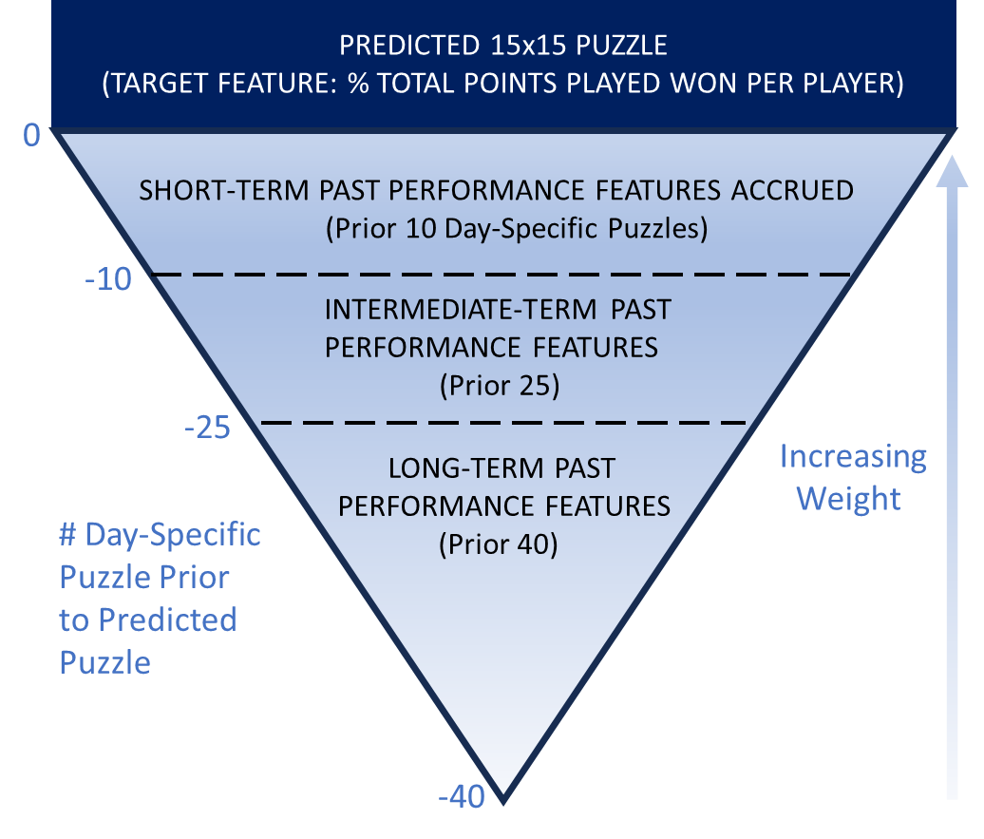
Solver Past Performance Features (n=9)
Decay-Time Weighted
(n=6/9)Dem
Puzzle: Clue or Answer Features
(n=19)
Puzzle Day of Week
(n=1)
Puzzle: Grid Features
(n=11)
Notes:
Fig. 2

Slide 11
Results

Slide 12
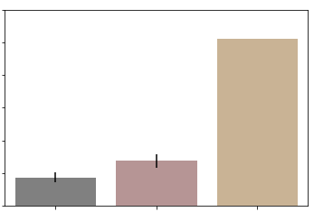
9
8
7
Training Error in minutes (RMSE)
6
5
4
3
Best Model
Mean PDS GMST
Dummy
Benchmark Models
Notes:
Fig. 7

Slide 13
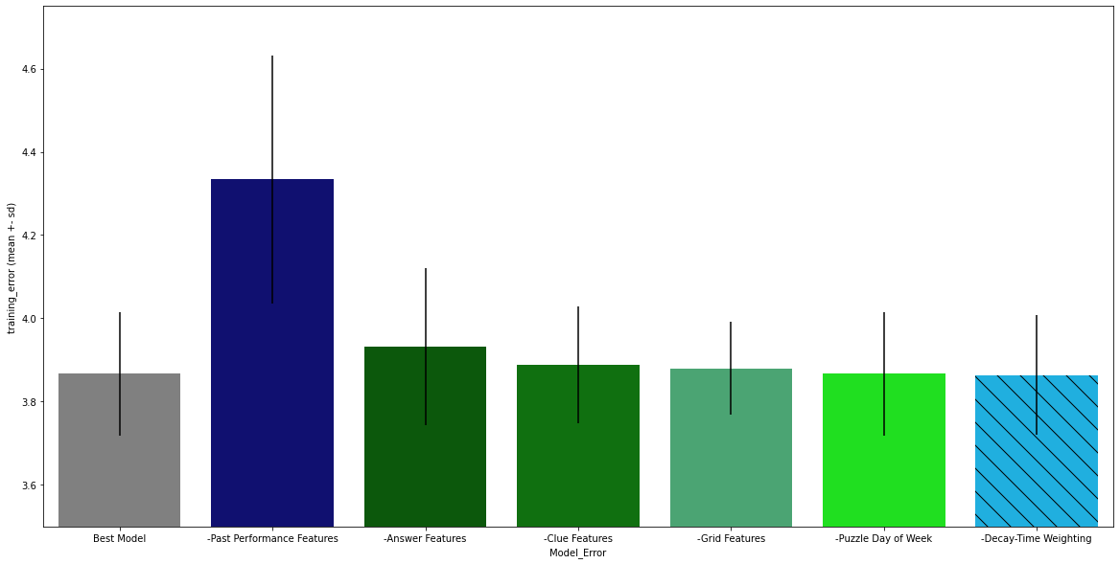
4.6
4.4
4.2
Training Error in minutes (RMSE)
4.0
3.8
3.6
Full Best Model
Past Performance
Answer
Clue
Grid
Puzzle Day of Week
Decay-Time Weighting
Subtracted Feature Class or Adjustment Type
Notes:
Fig. 8

Slide 14
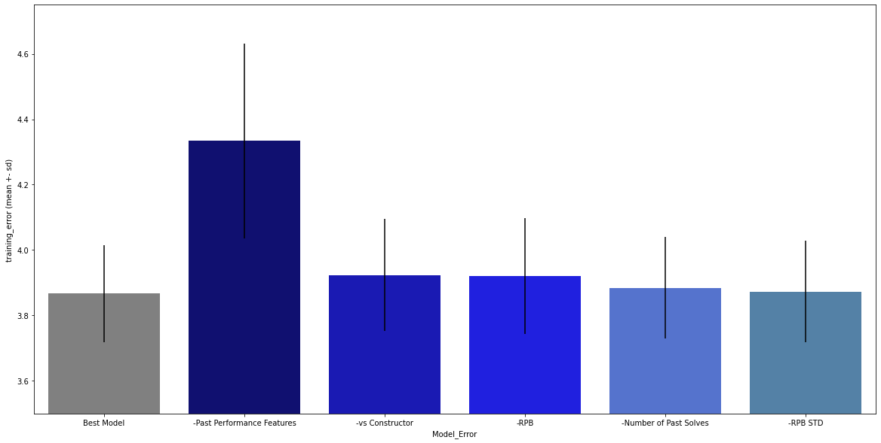
4.6
4.4
4.2
Training Error in minutes (RMSE)
4.0
3.8
3.6
Full Best Model
All Past Performance Features
Past Performance vs Constructor(s)
Recent Performance Baseline
# Past Solves
(Day Specific or Non-DS)
Std of Recent Performance Baseline
Subtracted Past Performance Feature(s)

Slide 15
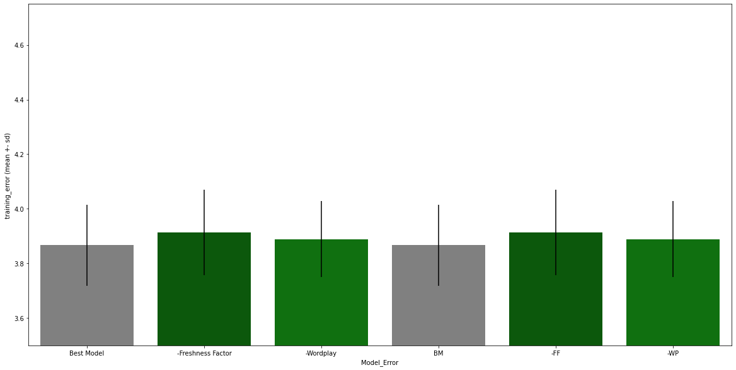
Full Best Model
Freshness Factor
(Answer)
Wordplay #
(Clue)
Subtracted Other Class Feature(s)

Slide 16
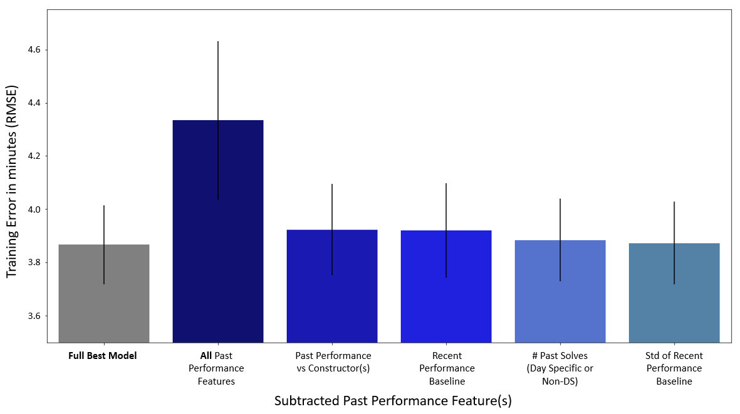
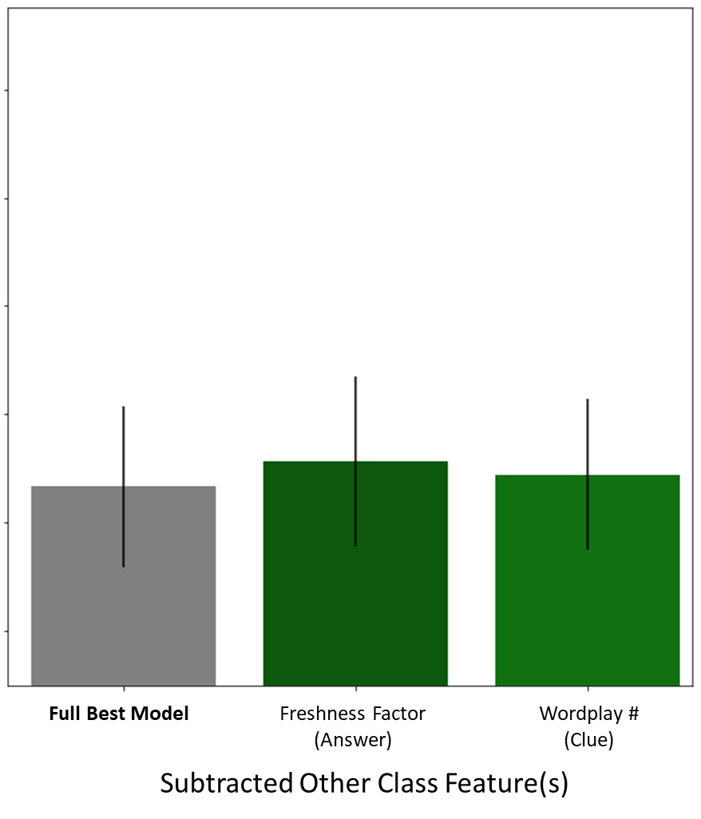
Notes:
Fig. 9

Slide 17
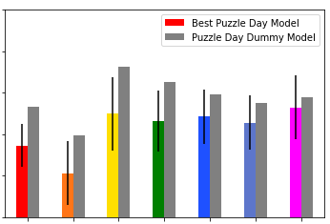
35
30
25
Training Error as % of mean solve time (RMSE)
20
15
10
Sun
Mon
Tue
Wed
Thu
Fri
Sat
Puzzle Day
Notes:
Fig. 10

Slide 18
Data Supplement

Slide 19
Puzzle Feature Name | Feature Class | Source(s) | Descriptions/Notes
GMST(m) | Target | XWStats | Global Median Solve Time found from ~1K-2K individual solves for each puzzle by Matt (XWStats)
GMS_RPB_l10 | Past Performance | XWStats/Me | Time-decay weighted mean of previous (to a given GMST) 10 puzzles, for the relevant 15x15 puzzle day
GMS_RPB_l25 | Past Performance | XWStats/Me | Time-decay weighted mean of previous (to a given GMST) 25 puzzles, for the relevant 15x15 puzzle day
GMS_RPB_l40 | Past Performance | XWStats/Me | Time-decay weighted mean of previous (to a given GMST) 40 puzzles, for the relevant 15x15 puzzle day
GMS_RPB_l10_stdev | Past Performance | XWStats/Me | Standard deviation of time-decay weighted version of GMS_pds_l10_dw (recent solve variability)
GMS_RPB_l25_stdev | Past Performance | XWStats/Me | Standard deviation of time-decay weighted version of GMS_pds_l25_dw (recent solve variability)
GMS_RPB_l40_stdev | Past Performance | XWStats/Me | Standard deviation of time-decay weighted version of GMS_pds_l40_dw (recent solve variability)
GMS Past Perf vs Constr | Past Performance | XWStats/Me | Past performance vs a specific constructor or specific constructor team; normalized to account for recent (past 40 puzzles) performance baseline per puzzle day (RPB) and past puzzle day mix for constructor(s)
Prior Solves # - DS | Past Performance | XWStats/Me | Number of solves on a given 15x15 puzzle day prior to a solve to be predicted; experience proxy
Prior Solves # - NDS | Past Performance | XWStats/Me | Number of solves across all 15x15 puzzle days prior to a solve to be predicted; experience proxy
DOW_num | Puzzle Day | Me | Assigns number to a given solve for the 15x 15 puzzle day of week (Mon-Sat)
Answer # | Grid | XWord Info | XWord Info calls answers “words”
Average Answer Length | Grid | XWord Info | XWord Info calls answers “words”
Blocks # | Grid | XWord Info | Blocks = black squares
Cheater Square # | Grid | XWord Info | Blocks than can be removed without affecting the overall word count of the grid
Circle # | Grid | XWord Info | Mostly seen in early week and Sunday puzzles
Open Squares # | Grid | XWord Info | Counts all white squares that are non-adjacent to black squares
Shade # | Grid | XWord Info | Counts all shaded squares in the grid; mostly seen in early week and Sunday puzzles
Spans # | Grid | XWord Info | Counts # of row or columns with 0 black squares (15 or 21 answer length, depending on grid size)
Stacks # | Grid | XWord Info | Counts # of times two or more adjacent rows or columns have all white squares (mostly Fri or Sat)
Unchecked Squares # | Grid | XWord Info | Squares that are part of only either the Across or Down clue, but not both
Unusual Symmetry | Grid | XWord Info | Assigns ‘1’ to all puzzles displaying other than normal rotational symmetry (e.g., L-R Mirror or Diagonal)
Cross Reference Clues # | Clue | XWord Info | Clue that refers to another clue (ex. “See 48-Down”)
Duplicate Clues # | Clue | XWord Info | When the same clue is used verbatim for more than one answer (uncommon)
Uniclue | Clue | XWord Info | When the same clue is used for both an Across and a Down entry (very rare)
Wordplay # | Clue | Manual (me) | Subjective count of clues displaying wordplay/punnery; many end with a ‘?’, ‘perhaps’, or ‘maybe’
Black Square Fill # | Answer | XWord Info | Number of black squares in the grid that contain at least one character (very rare)
Day Freshness %ile | Answer | XWord Info | Assigns percentile across all puzzles for the puzzle day of a given puzzle for Freshness Factor
Duplicate Answers # | Answer | XWord Info | When the same answer is used verbatim for more than one clue (rare)
Fill-in-the-Blank # | Answer | XWord Info | Number of fill-in-the-blank answers in a given puzzle
Freshness Factor | Answer | XWord Info | Assigns an overall rarity score to a puzzle’s answers, using both pre-Shortz and Shortz puzzles
Outside Grid # | Answer | XWord Info | Number of “virtual” squares outside the grid that contain at least one character (very rare)
Overall Freshness %ile | Answer | XWord Info | Assigns percentile across all puzzles from all puzzle days for Freshness Factor
Quantum | Answer | XWord Info | 1 denotes more than 1 valid answer for a clue (very rare)
Rebus # | Answer | XWord Info | Counts number of squares where more than one letter, number or symbol is required for a solve
Rebus Unique # | Answer | XWord Info | Same as above, but only counts squares with unique rebus content in the given puzzle
Scrabble Average | Answer | XWord Info | Treats each white square like a (non-blank) Scrabble tile and assigns per-square average point value
Scrabble Illegal # | Answer | XWord Info | Counts all answers that would not be playable based on the Official Scrabble Dictionary
Scrabble Score | Answer | XWord Info | Treats each white square like a (non-blank) Scrabble tile and assigns total point value for the puzzle
Unique Answer # | Answer | XWord Info | Counts all answers not occurring in any other pre-Shortz or Shortz Era puzzle
Unused Letters # | Answer | XWord Info | Counts the number (out of 26) of letters not used in a puzzle (0= pangram)
Notes:
Supp. Table 1

Slide 20
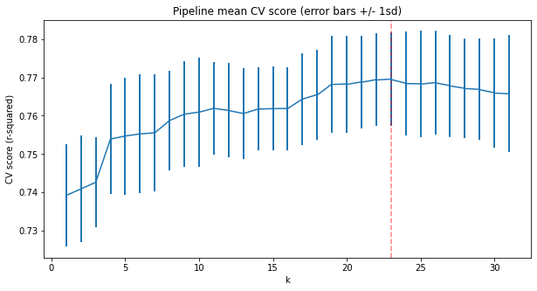
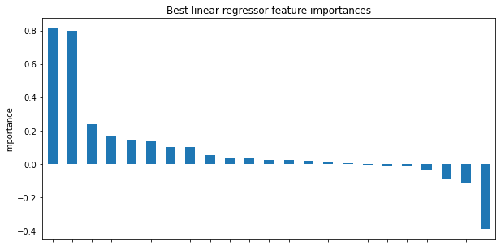
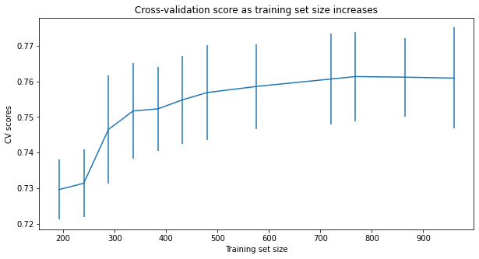
A
B
Rebus #
Circle #
Shade #
RPB_l40
Answer #
Blocks #
DOW_num
Wordplay #
RPB_l40_std
C
Rebus Unique #
Open Squares #
Scrabble Score
Scrabble Illegal #
Freshness Factor
Unique Answer #
Fill-in-the-Blank #
Prior Solves-DS #
Past Perf vs Constr
Prior Solves-NDS #
Cheater Squares #
Overall Freshness %ile
Average Answer Length
Cross Reference Clues #
Features
Notes:
Supplementary Fig. 1

Slide 21
Not Used

Slide 22
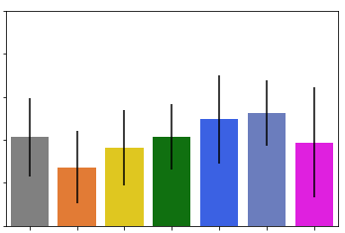
30
28
26
Training Error as % of mean solve time (RMSE)
24
22
20
Best Model
(matched n)
Mon
Tue
Wed
Thu
Fri
Sat
Puzzle Day Subtracted
Notes:
Not in summary (one day subtracted each run)

